Slide 1

Industry Project Presentation on “Integrated Learning Journey: From Discovery to Advanced Application Development”
By
Meet Prajapati (20162121010)
Institute of Computer Technology, Ganpat University
Date:09-05-2024

Slide 2
Table of Contents
Week 1: Product Understanding: Viaje.ai
Week 2: Knowledge Test
Week 3: Codebase Assignation & Overview discussion
Week 4: Login Page & Bug Discussion
Week 5: Login Page & Bug Solving
Week 6: Login page & feature implementation
Week 7: Understanding Vulnerability Assessment and Penetration Testing Standards
Week 8: Implementing Vulnerability Assessment and Penetration Testing Standards
Week 9: Exploring DataTables, SQL, and NoSQL Databases
Week 10: Mastering Django Framework
Week 11: Integrating FastAPI and ReactJS
Week 12: Advanced Applications with FastAPI and ReactJS

Slide 3
Week 1: Product Understanding: Viaje.ai
What is viaje.ai
Insides of viaje.ai & travel industries
Features & module of product
Assignment related to their product calculation
Tests & research reports
UI template building
initial test on Django, html, css, bootstrap, MongoDB and MySQL

Slide 4
Week 2: Knowledge Test
Queries related to their database:
Mysql queries
MongoDB queries
Scraping website overview
google news fetch scripting
wireframe guidelines and demo related to login page

Slide 5
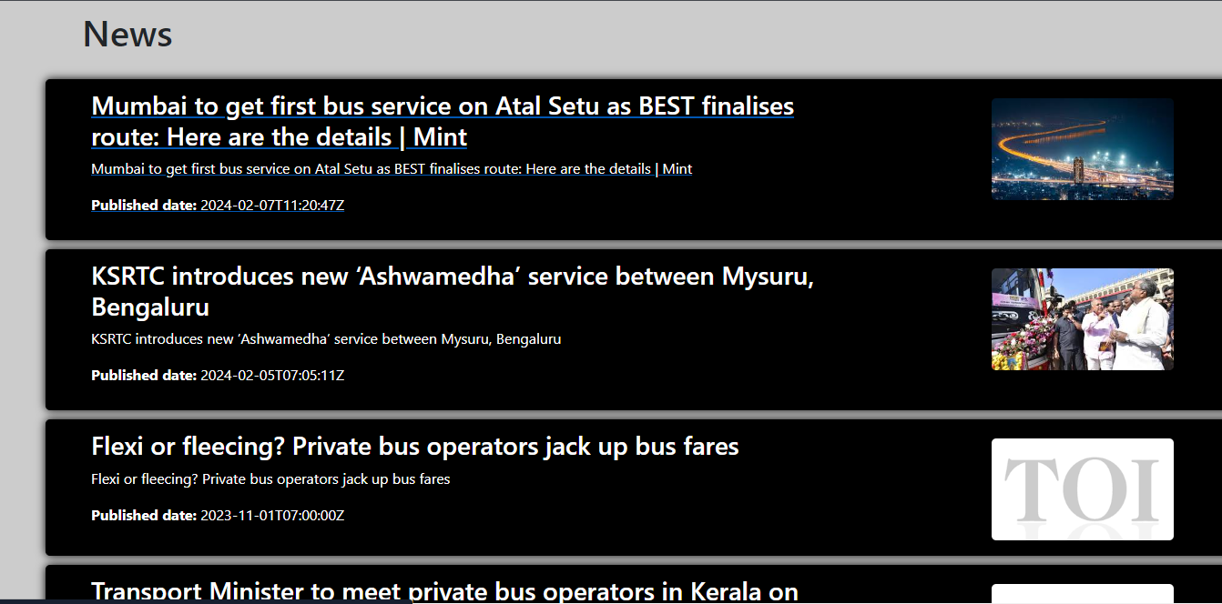
Scraping of google news

Slide 6
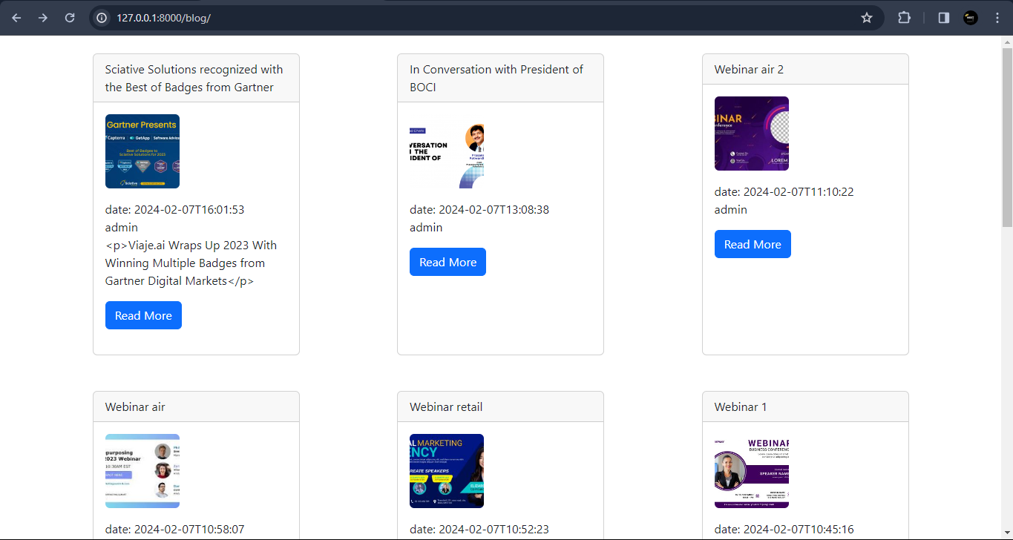
Wordpress-api integration with Django

Slide 7
Week 3: Codebase Assignation & Overview discussion
Tools and technology installation
server setup in PC
codebase Knowledge Transfer
server setup/configuration with DBs
Bugs Solving
UI Enhancement in product
Design documentation for product login page
Dbs model design
Login Page UI Building according to wireframe assigned earlier

Slide 8
Week 4: Login Page & Bug Discussion
Bugs Fixing
API building for product Login page
MacOS & windows code compatibility check up
and also update code as per the needs
Unit testing for bugs
QA changes & making Live for the clients and operators

Slide 9
Week 5: Login Page & Bug solving
Bugs Fixing
Knowledge transfer session for moving Backend functionalities to Frontend functionality
Login page API building for the all the forms on Admin side

Slide 10
Week 6: Login page & feature implementation
Bugs Fixing
integrating all the api to login page
Wireframe changes and their implementation
Enhancement in Site
URL mapping
JQuery / AJAX call

Slide 11
Week 7: Understanding Vulnerability Assessment and Penetration Testing Standards
Participants grasp foundational concepts of Vulnerability Assessment and Penetration Testing (VAPT) standards.
Focus on methodologies, tools, and best practices in VAPT.
Password policy standard understanding
Login security
Captcha functionality
Account lockout
25/03/2024

Slide 12
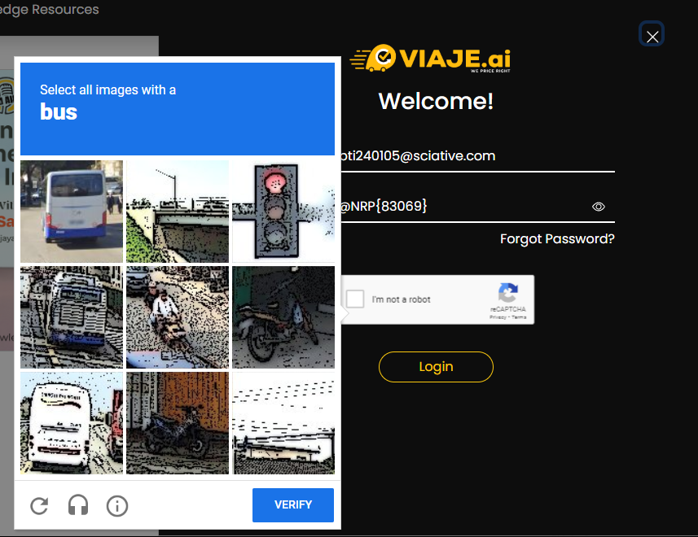
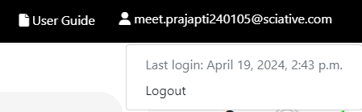
Recaptcha

Slide 13
Week 8: Implementing Vulnerability Assessment and Penetration Testing Standards
Password policy standard understanding
Login security
Captcha functionality
Account lockout
reset password functionality
25/03/2024

Slide 14
Week 9: Exploring DataTables, SQL, and NoSQL Databases
understanding concepts of SQL
RDS functionality
CRUD operation
indexes
stored procedure
Aggregation functions
25/03/2024

Slide 15
Week 9: Exploring DataTables, SQL, and NoSQL Databases (cont.)
NOSQL
mongodb concepts
index,
find,
update,
aggregation pipeline
attributes ($sum, $regex, $count, $min , $setOnInsert etc…)
25/03/2024

Slide 16
Week 10: Mastering Django Framework
Understanding MVC (Model-View-Controller) Architecture:
dynamic routing
ORM (Object-Relational Mapping)
URL Routing and Views
Templates and Static Files
Authentication and Authorization
25/03/2024

Slide 17
Week 11/12: Advanced Applications with FastAPI and ReactJS
Building APIs with FastAPI
Dependency Injection in FastAPI
Request Validation and Data Serialization
Asynchronous Programming with FastAPI
Security Features and Authentication in FastAP
JWT Token Understanding
25/03/2024

Slide 18
Week 11/12: Advanced Applications with FastAPI and ReactJS (cont.)
Component-Based Architecture in ReactJS
State Management with React Hooks
Handling User Input with Forms in ReactJS
React Router for Client-Side Routing
Consuming APIs and Fetching Data in ReactJS
FastAPI and ReactJS Integration
25/03/2024

Slide 19
Thank You !!

